Slide 1
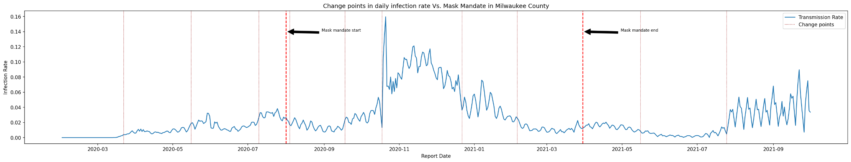
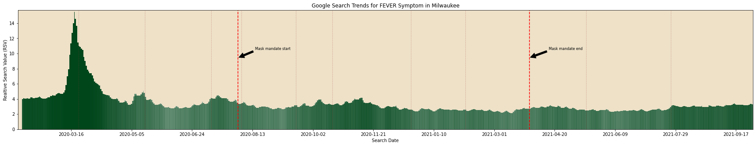
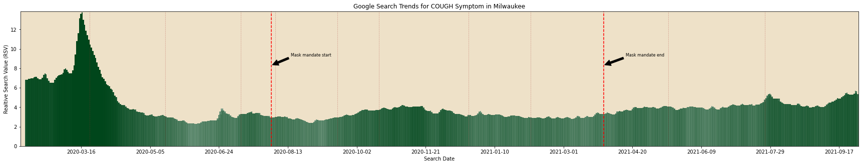
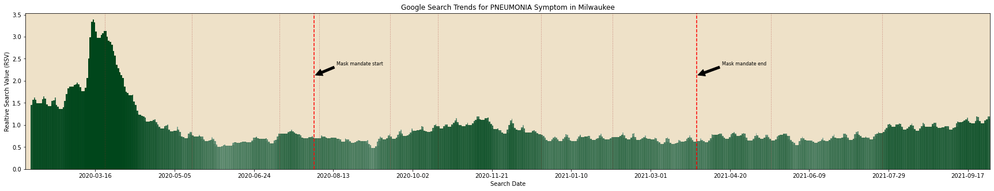

Slide 2
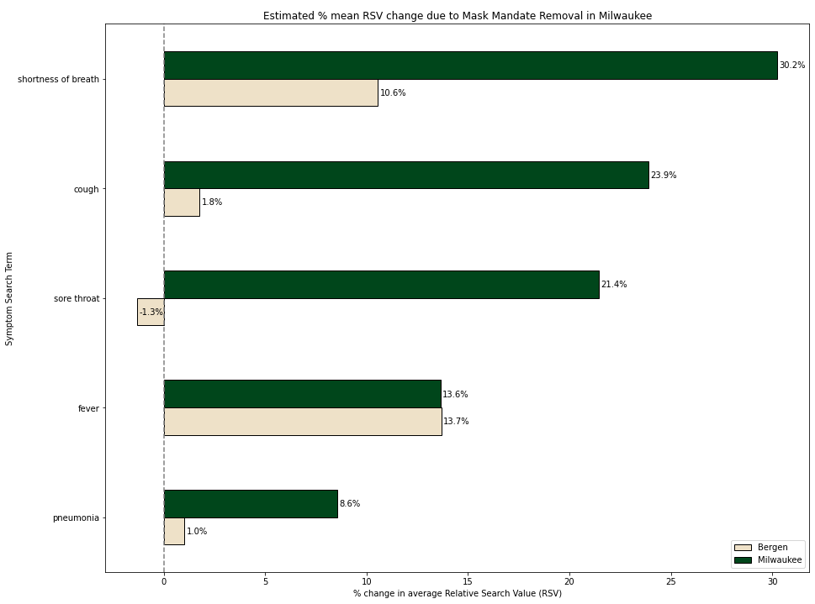
Difference-in-Difference
Impact of removing Mask Mandate on Symptom Searches (Milwaukee Vs. Other County with Continuous Mask Mandate)

Slide 3
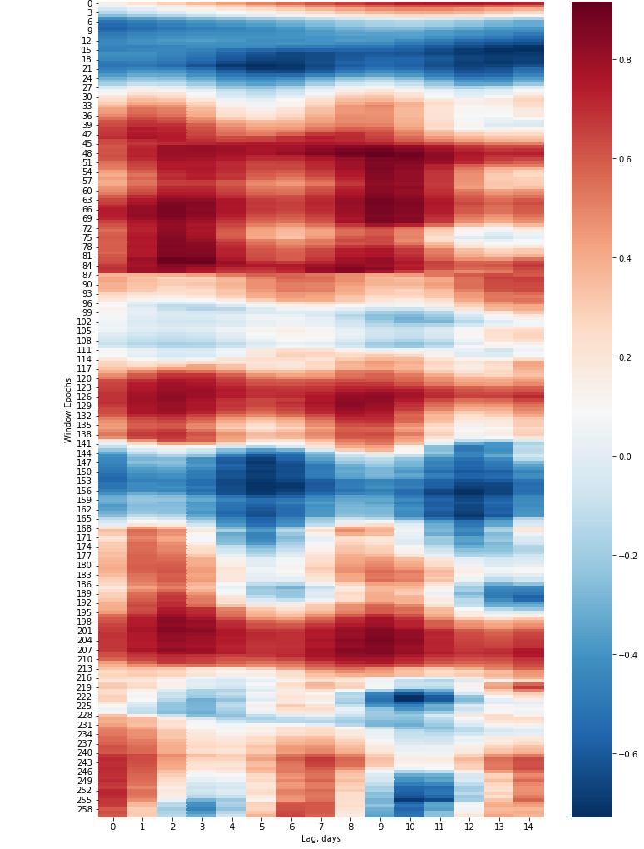
Mask Mandate Started
5th Change Point
8th Change Point
Mask Mandate Ended

Slide 4
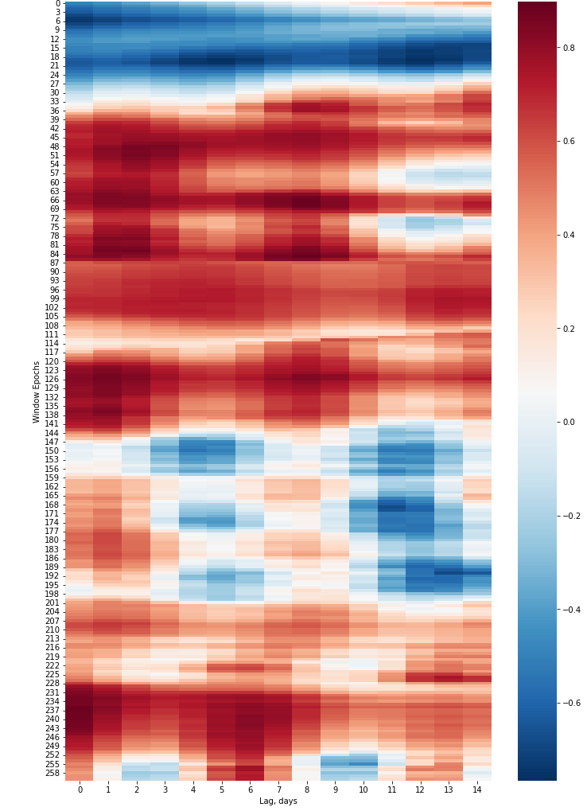
Mask Mandate Started
5th Change Point
8th Change Point
Mask Mandate Ended

